Slide 1
Insights Discovery Support Options 2024

Slide 2
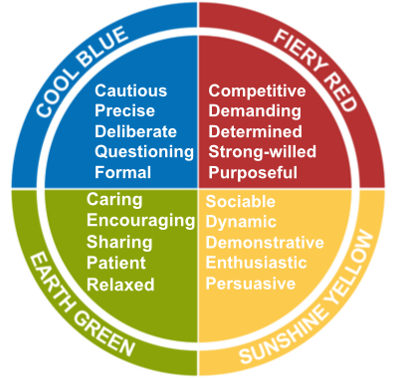
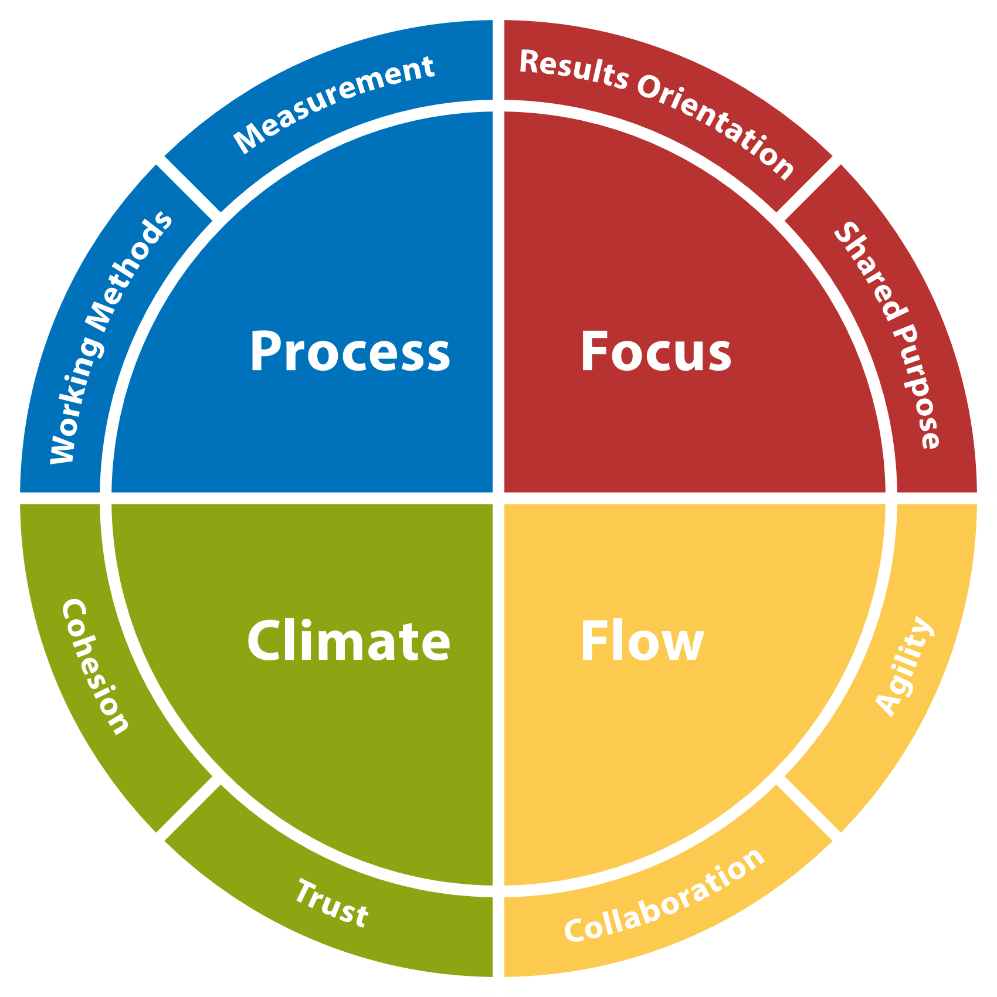
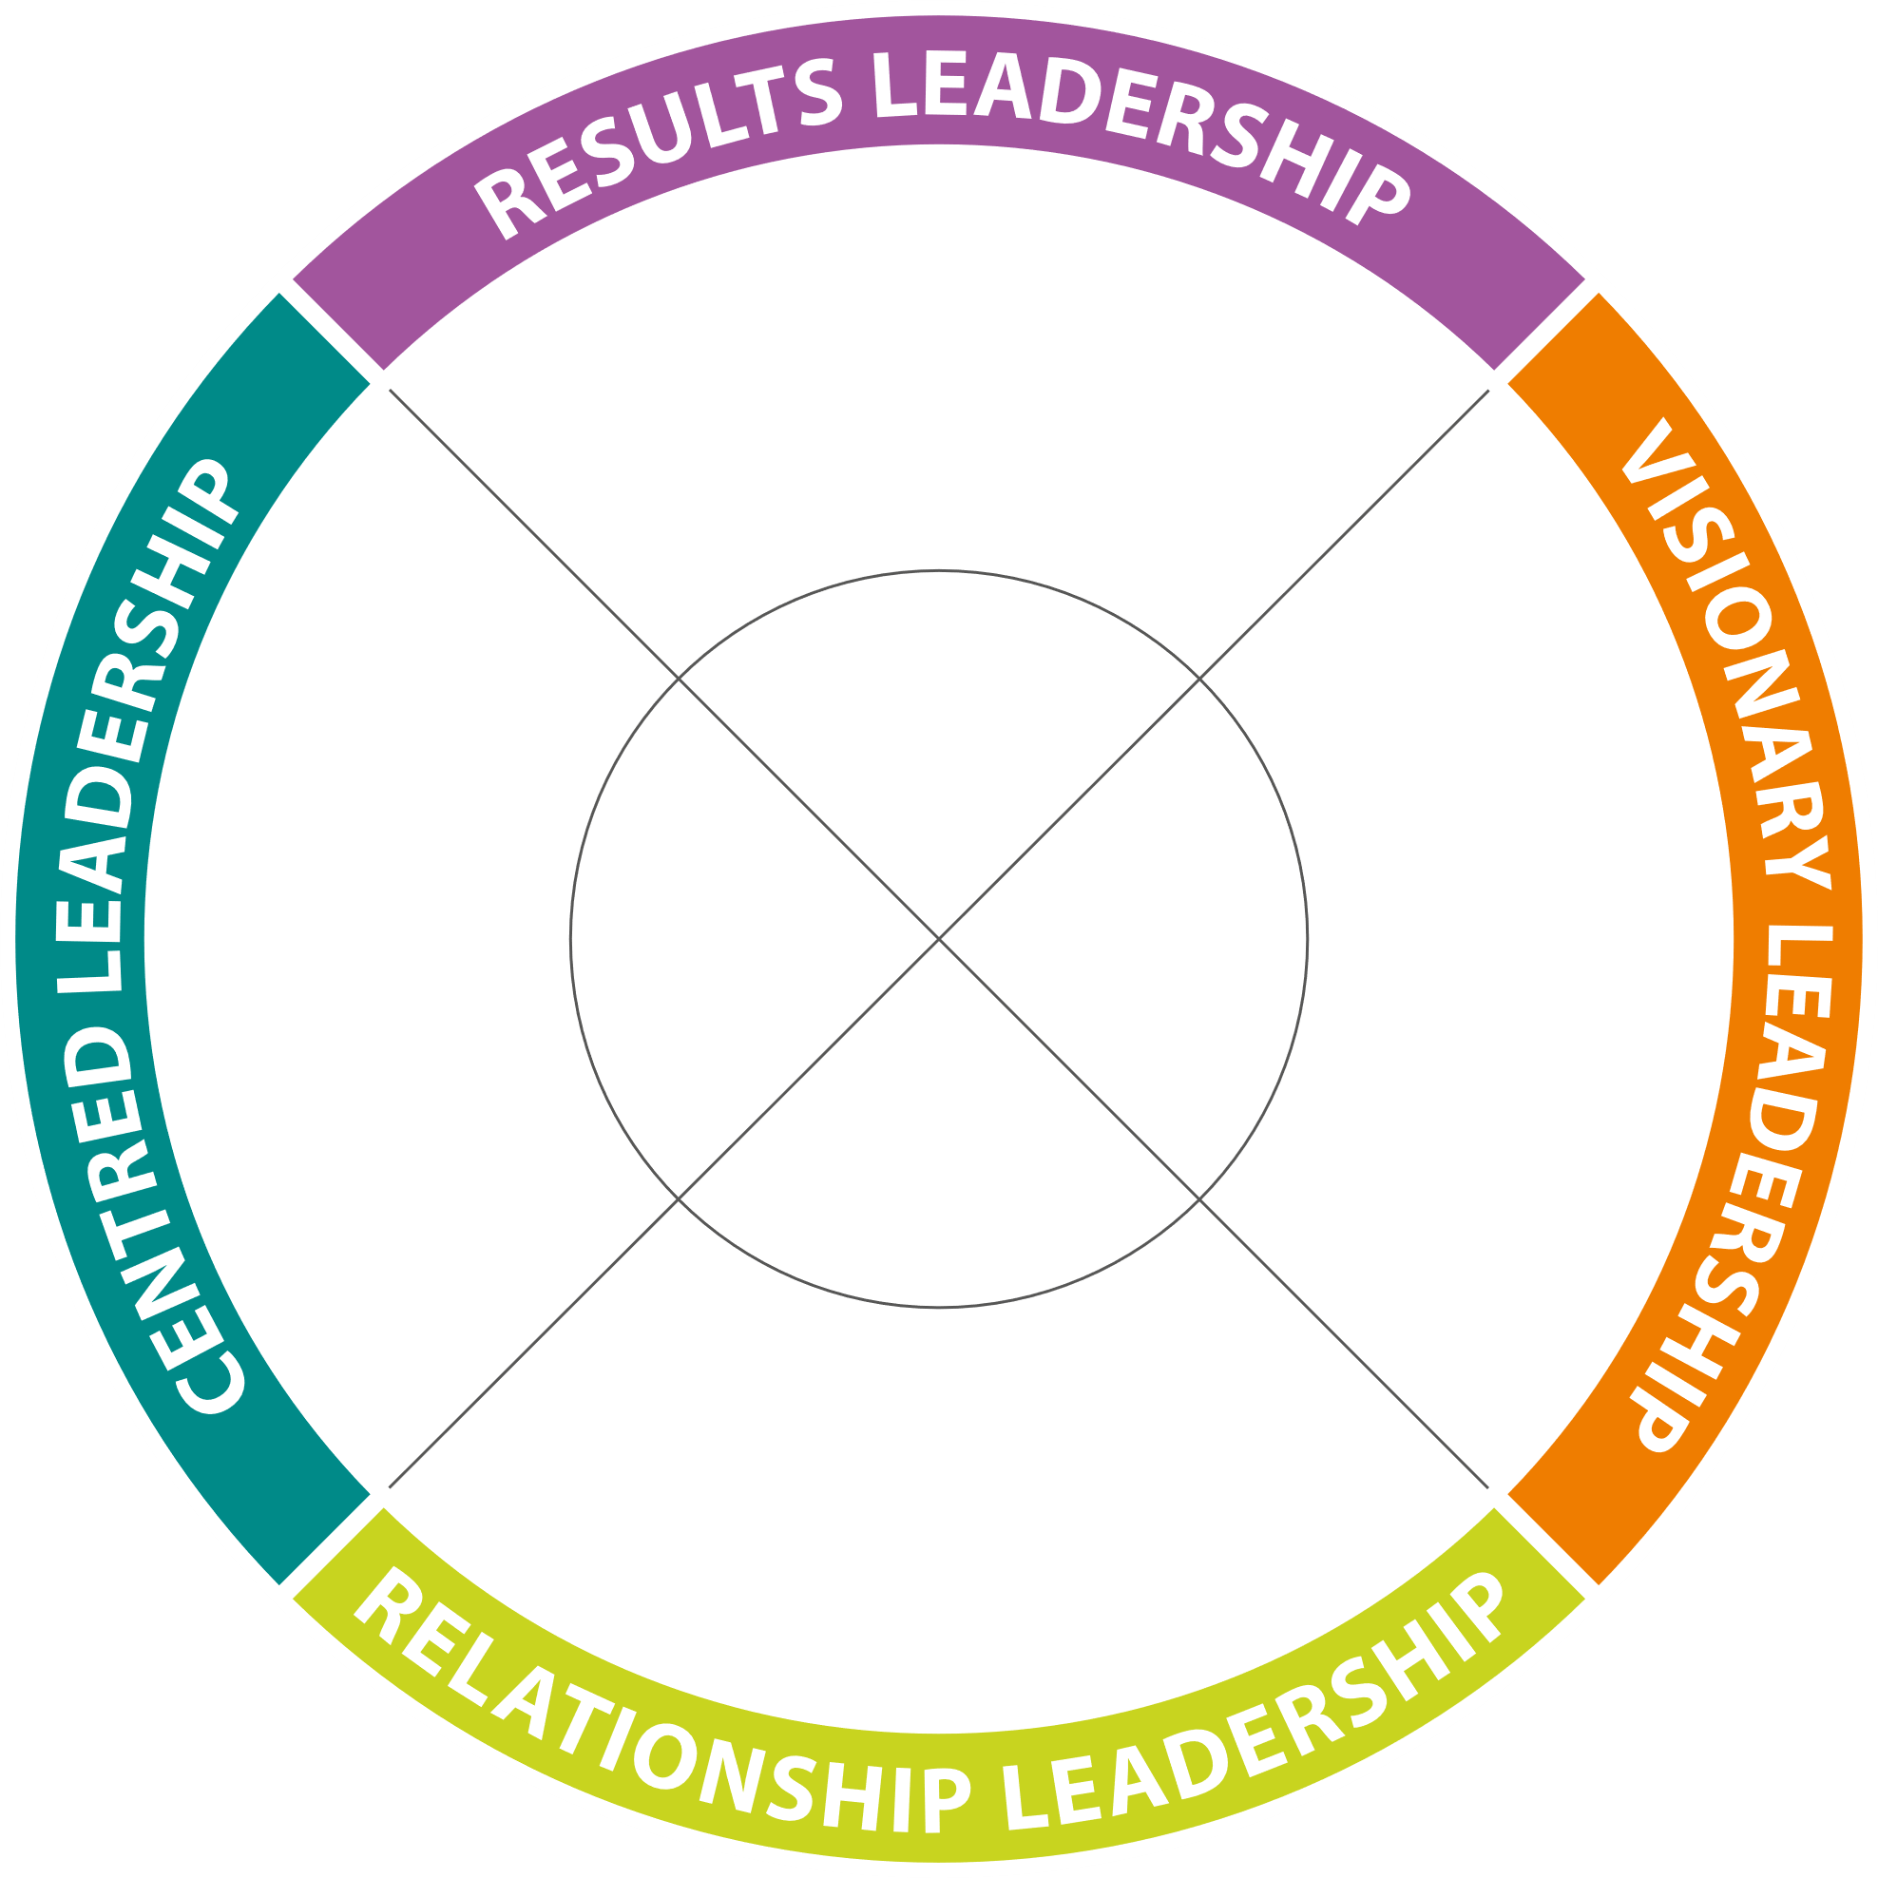
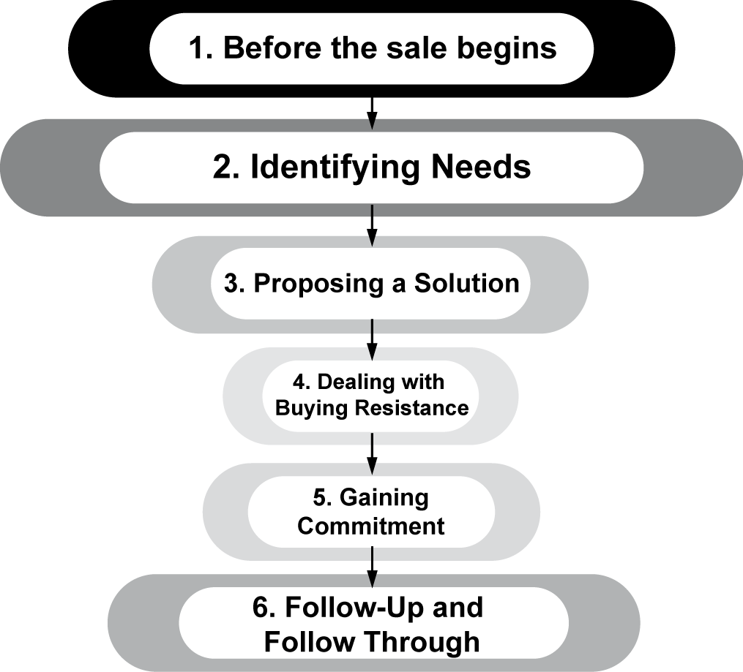
Insights Discovery supports your People Development Strategy in Four Key Areas:
Insights Discovery – Personal Effectiveness
Insights Discovery – Leadership Development
Insights Discovery – Team Effectiveness
Insights Discovery – Sales/Influencing Approach

Slide 3
Introductory Team Workshop – Sample Overview
Introduction & Mindset: Setting the session up for success and the impact of our mindset on our life and work
Perception: We see the world not as it is, but as we are.
Introduction to Insights Discovery: Understanding the Insights Discovery model, individual preferences and how this impacts our relationships
Sharing Profiles: Self reflection and team sharing around communication preferences
Review of Team Wheel: Discussion and observations around team dynamics and effectiveness.
Practical Application & Tools: How can you use your profile on a daily basis as a team?
Investment
Insights Discovery Profiles & Workshop Materials: £150 + VAT per person (Foundation, Management Chapters)
Online workshop facilitation & preparation: £1100 + VAT (half day)
In person facilitation: £1500 + VAT (for half day) or £2250 + VAT (for a full day)
One to One Coaching £250 + VAT per person per coaching session- optional extra to support with one to one action planning

Slide 4
Follow Up Workshop Themes

Slide 5
One to One Coaching
One to one coaching sessions for individuals to help people understand their own Insights Discovery Profile and get their perspective on the team – what’s working well and what would make things even better.
We will arrange for one to one coaching virtually as per requirements
A variety of coaching topics can be covered over a number of coaching sessions, normally individuals undertake 4-6 coaching sessions over a period of 6 months
Coaching Investment
= £300 + VAT for profile and first coaching session
= £250 + VAT for ongoing coaching sessions

Slide 6
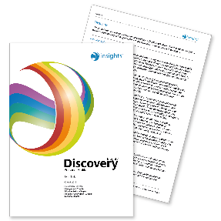
Recorded Video & Profile Option
Insights Discovery Profile – Foundation & Management Profile
60 minute pre-recorded webinar to give individuals context of the Insights Discovery Model and a more self directed and cheaper price point
Coaching Investment
= £225 + VAT total investment including the Insights Discovery Profile & Recorded Video

Slide 7
Example of Recent Leadership Programme

Slide 8
Key Modules
5
Growth Mindset & 360 Feedback
2
Effective Leadership
Strategic Planning & Collaboration
4
1
3
Introduction to Insights Discovery
Communication & Challenging Conversations

Slide 9
Module Overview: Introduction to Insights Discovery
Purpose
Introduction to the Insights Discovery Model
Greater understanding of Self and Others
Create time and space to think, reflect and think about your approach
Agenda Overview
Perception
Introduction to Insights Discovery
Your Insights Discovery Profile
Profile Share
Team Wheel
Communication
Practical Tools

Slide 10
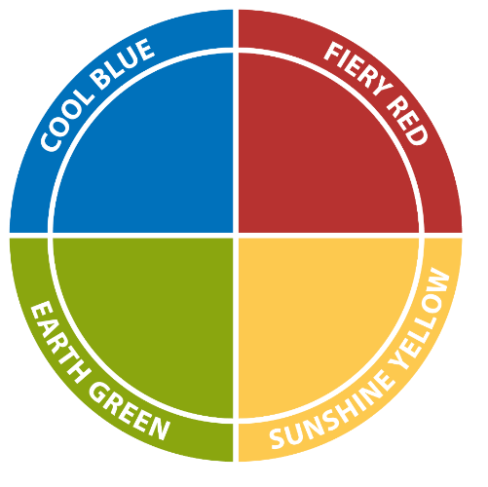
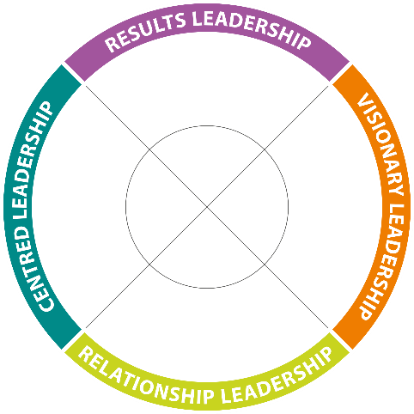
Module Overview: Effective Leadership
Purpose of Effective Leadership Session
To create space to consider how you can further use Insights Discovery
Bring awareness to the strengths and gifts each colour energy brings in leadership
Provide you with some practical ideas and tools which you can use
What is Leadership?
Colour Energies in Leadership
Four Manifestations of Leadership
Leveraging Strengths & Motivating A Team
Agenda for Today

Slide 11
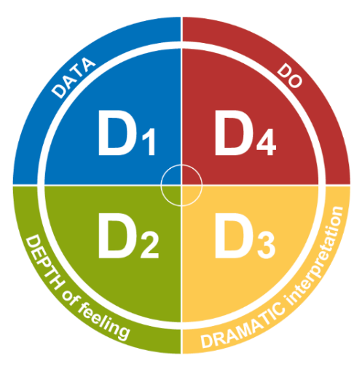
Module Overview: Communication & Challenging Conversations
Purpose of Challenging Conversations Module
To create space to consider how you communicate
Consider different approaches to giving feedback
Provide you with some practical ideas and tools which you can use straight away
Communication Strategies using the Colour Energies
4Ps Communication Model
Your experience of challenging conversations
Crucial Conversations
D4 Feedback Model & Examples
Reflection
Agenda for Today

Slide 12
Module Overview: Strategic Planning & Collaboration
Purpose of Module
To create space to consider how you can further use Insights Discovery in every day approaches to being more strategic
Practical way to consider how to bring in a more strategic approach to individual leaders and collaboratively as a team
Considering ways of working with other leadership team members to best lead and engage the organisation as a whole
Value & approach to strategic planning
Individual approach to strategy
Collaboration to deliver strategy
Collaboration in Action: Utilising collective strength of the leadership team
Agenda for Today

Slide 13
Module Overview: Growth Mindset & 360 Feedback
Purpose of Module
To understand the power of mindset in leadership
To encourage the leaders to think about how they can impact their mindset to enhance their leadership approach
To enhance understanding and accountability of being a leader within Oh Polly
To gather 360 feedback on their style to further enhance self awareness
Fixed v Growth Mindset
Shifting Perspective
Resilience Toolkit
Understanding 360 Feedback & How this impacts how we approach our leadership role – strengths & development areas
Programme Close & Action Planning
Agenda for Today

Slide 14
Further Reading Information

Slide 15
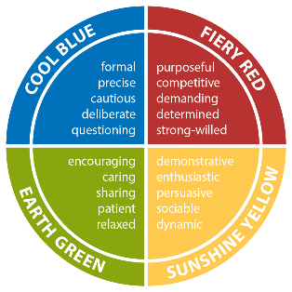
About Insights Discovery
Self-awareness is the foundation of excellent teamwork, improved communication, enhanced productivity and truly inspirational leadership. Insights can raise the level of self-awareness throughout your organisation, and help you move into a highly successful future.
The Insights Discovery model is a simple and accessible four-colour model which, accompanied by an Insights Discovery Personal Profile, helps people to understand more about themselves and others.
It creates a common language that makes it easier to identify strengths and address weaknesses, so that individuals and teams can perform at their highest level.
This model provides an effective foundation for learning programmes since it inspires individuals to think about how they act and communicate.
Every person has all four colour energies within them but has a natural preference for some over others which influence their motivations and behaviour; it is the combination of these energies which creates each unique personality.
By understanding your own and others’ preferences better, you can take simple, practical actions that improve your everyday relationships. The Insights Discovery Personal Profile is your guide, enabling you to take control of your own development.
Supporting your existing tools
Our purpose is to help you use the Insights Discovery system to accelerate the transformation of your business and the personal growth of your people. One of Insights Discovery's greatest features is its versatility; it can integrate and support other systems already in place by providing a common, easy-to-use language that is shared across whole organisations.

Slide 16
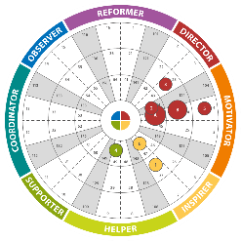
Benefits of Insights Discovery
The Insights Discovery methodology allows individuals to view their personal preferences in relation to those of others, making it easy to identify where they may come into conflict, and where they share common ground.
Team wheels give you a highly visual representation of your team’s personal preferences
Some of the advantages of Insights Discovery that learners have listed:
Using meaningful words like Fiery Red or Earth Green makes everything more memorable.
Being able to compare wheel positions in a team is very impactful.
The profiles have great Information that can be applied on a daily basis, both inside and outside the workplace.
In addition, the Insights Discovery model is registered with the British Psychological Society and carries their PTC mark of approval for use in work and occupational development. Insights Discovery has also been awarded the coveted Occupational Test Tools Certification Mark, from global quality assurance and psychological test assessors DNV GL.

Slide 17
The Insights Discovery Personal Profile
The Insights Discovery Personal Profile is a detailed report about each individual which is produced based on their responses to an evaluator. It contains valuable information about the individual's personality and communication preferences that can be used as an aid to self-development in the workplace.
Foundation Chapter
Every profile begins with the Foundation Chapter, which tells individuals about their style and approach. It includes the following sections:
Overview
Key Strengths and Weaknesses
Value to the Team
Communication
Possible Blind Spots
Opposite Type
Suggestions for Development
Download a sample here.
This gives the individual a good understanding of their unique preferences so that they can start to make practical, relevant changes that improve their working processes and relationships.
Management Chapter
We believe that everyone is a leader in their own way. It’s how you lead, not what you lead, that really matters. The Management Chapter helps people to understand how they manage, and how they prefer to be managed. It is useful for both leaders and the people they lead to explore the best ways of working together, improving both their relationships and performance. This chapter focuses on:
• How people like to manage and be managed
• How to motivate others and be motivated
• Creating an ideal work environment for yourself and others

Slide 18
Insights Transformational Leadership Model
The Insights Transformational Leadership Model offers you the opportunity to understand how your preferences impact your leadership style, with a view that we can all adapt and flex our style. Leaders can evaluate their approach and in workshops gain feedback from their colleagues around how they show up. There are four key leadership approaches we explore within transformational leadership these include: Relationship Leadership, Centred Leadership, Results Leadership and Visionary Leadership. We can help you plot your team wheel and evaluate areas we may consider for development. We can run workshops in an online, in person or coaching format.
Examples of Leadership Modules
Communication: Sharing individual communication preferences; Motivators & Blockers; Adapting your communication style; Discussion re team communication; 4Ps model to support broad communication.
Leadership 360 Feedback: Using the Insights Discovery Full Circle Profile to invite feedback from up to 12 people to review how others see you for personal growth. This session is recommended to be in a later part of the development programme to ensure individuals are resilient enough to receive the feedback and use it constructively
Leadership Team Strategy: Reviewing our Team Effectiveness, Leveraging our leadership team strengths; Areas for development; Maximising your separate teams.
Leadership Approach: Building your leadership brand; Effective leadership, Insights Transformational Leadership Model; Leadership Legacy.
Performance Management: Crucial Conversations; Giving Feedback using D4 model; Coaching to get the best out of different personality types; Leading Team Meetings; Running One to Ones.
.

Slide 19
Team Effectiveness Model
The Insights Team Effectiveness Model is a great organizational and team tool to enable evaluation of performance of teams against the four pillars of team effectiveness: Process, Focus, Climate and Flow.
We have an online survey – which we can provide you access to see – that asks team members for their feedback on various elements of the team effectiveness pillars e.g. trust, communication, motivation. This can then be used as a starting point for leaders and teams to consider areas to enhance performance and employee engagement.
The theory behind this model suggests that a high performing team needs to comprise of all of these elements. For many teams this is a great start point to evaluate, discuss and take action on a premise of ‘How can we make our team even better if…’
Workshops around team effectiveness can be delivered online or in person. Also, the data from these sessions can provide excellent organizational data to help with leadership decision making and communication, which could fit in really well with where you are organizationally.

